Slide 1
Thus, the last will be first, and the first will be last.
– Matthew 20:16
Lecture 4 (2) – Fundamental Data Structures (Part 2)
CST370 – Design & Analysis of Algorithms
Dr. Byun
Computer Science

Slide 2
Lecture Objectives
After completion of this lecture, you will be able to
  understand the basic terminologies of weighted graphs and trees in computer science.

Slide 3
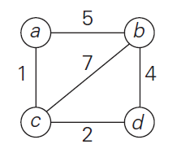
Weighted Graphs
Watch this video first
  https://youtu.be/9r2yyJgFQxU
A weighted undirected graph and a weighted directed graph are graphs with numbers (or cost) assigned to their edges.
Example

Slide 4
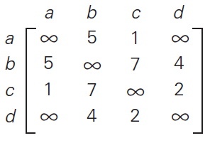
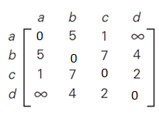
Weighted Graphs Representation –
Adjacency Matrix
➔
➔
// You can put 0’s on the main diagonal.

Slide 5
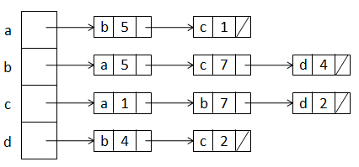
Weighted Graphs Representation –
Adjacency List
➔

Slide 6
Exercise
Represent the following graph in adjacency matrix and adjacency list.
2
a
b
5
8
c

Slide 7
Paths and Cycles
Read the textbook (or search Internet) to study the following terminologies in a graph.
  Path
  Length
  Simple path
  Connected
  Connected component
  Cycle
  Acyclic graph

Slide 8
Question (1 of 2)
Is the graph connected? No.
  The graph has two connected components.
e
a
b
c
d

Slide 9
Question (2 of 2)
Is the graph connected? Yes.
  It has one connected component.
Is there a cycle? No.
e
a
b
c
d

Slide 10

Puzzle
Assume that there are 10 balls and a scale.
  Assume also that there is a fake ball among the balls, .
  But we don’t know if the fake is lighter or heavier.
How can you identify if the fake ball is lighter or heavier compared to the genuine balls?
  Note that you don’t need to find the fake ball itself. You just need to identify if it’s lighter or heavier.

Slide 11
Solution

Slide 12
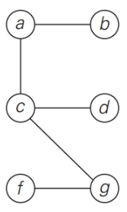
Trees
Watch this video first
  https://youtu.be/3n09brVylNI
Note that a tree is actually a graph (= connected acyclic graph).
Example

Slide 13
Free Tree, Rooted Tree, and Ordered Tree
There are several different trees in computer science theory such as (free) trees, rooted trees, and ordered trees.
  Our main interest in the class is the binary tree and binary search tree.
  However, it would be great for you to know the general terminologies of trees mentioned in the textbook as a computer scientist.

Slide 14
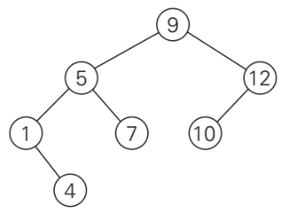
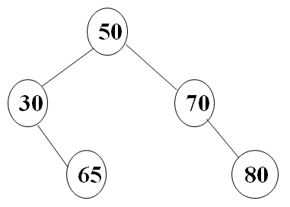
Binary Tree
Is this a binary tree?
(a)
(b)

Slide 15
Binary Search Tree (BST)
Is this a BST?
(a)
(b)

Slide 16
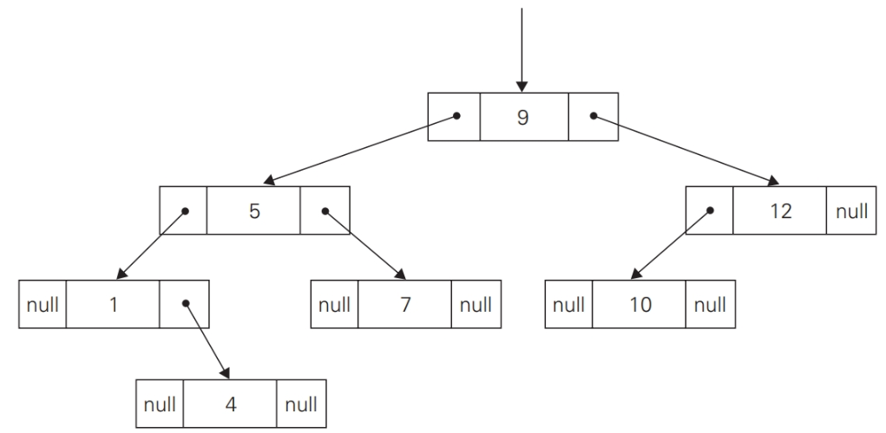
Standard Implementation of Binary Tree

Slide 17
Sets
A set is an unordered collection of distinct items.
Example
  S = {2, 3, 5, 7}
  S = {n: n is a prime number and n < 10}
Important set operations
  Membership check
  Union and intersection
  etc.

Slide 18
Sets vs. Lists
Mathematically, the main differences between a set and a list are duplication and order.
  Set: No duplication and don’t care the order (= sequence).
  List: Duplication is fine but order is important.

Slide 19
Puzzle
Assume that the current time is 3:00(PM).
  Then, the angle between the hour and minute hands is 90 degrees on a classic analog watch.
If the current time is 3:15(PM), what is the angle between the two hands?

Slide 20
Solution

